Slide 1
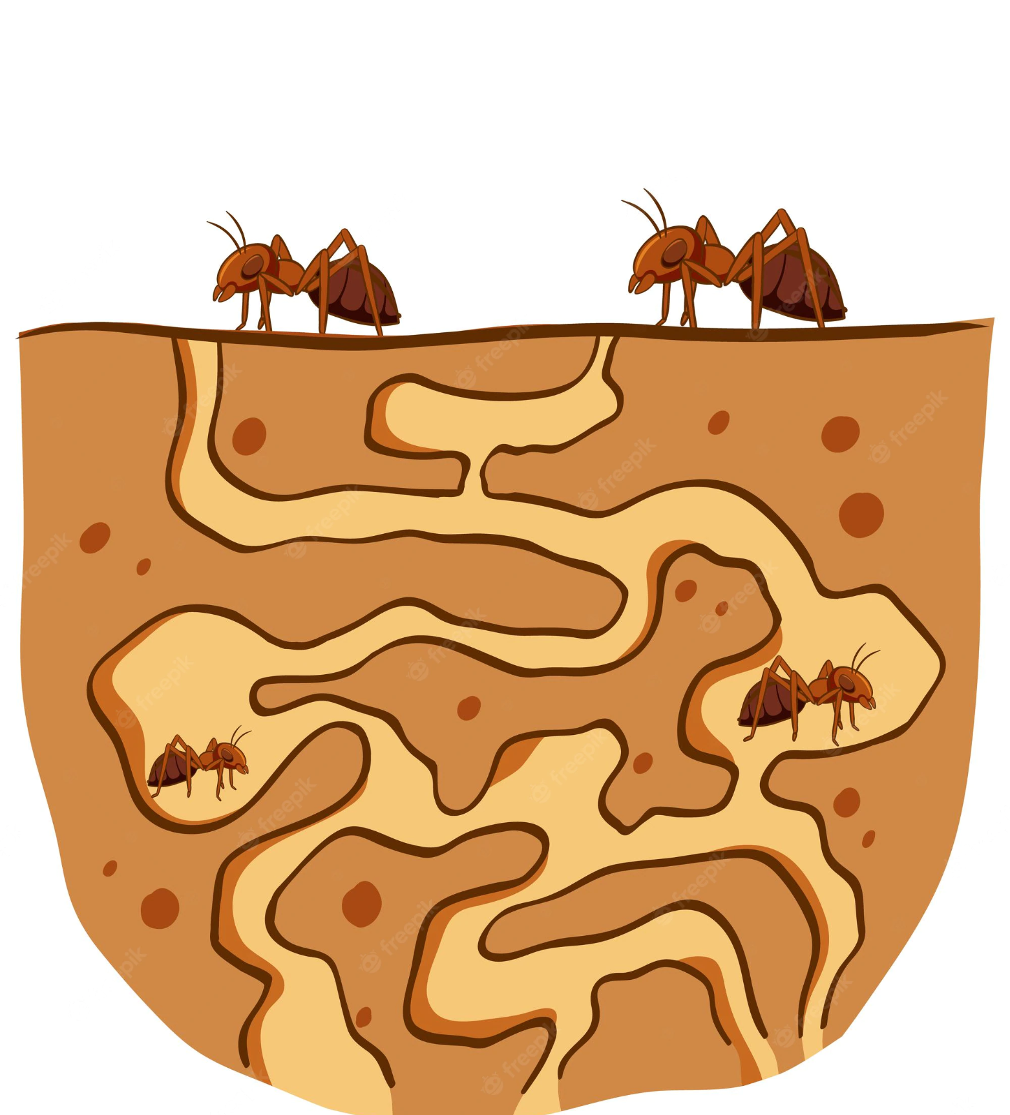
Ant Colony Simulation

Slide 2

Index
1
Project description & Objective
2
Assumption
3
The model
4
Simulations: the results
5
Conclusion

Slide 3
Introduction
1
Project description & Objective

Slide 4

Ant Colony
An ant colony is a self-organised (not a hierarchical) system that adapt to the environment.
The ants are really important for the ecosystem because they:
Aerate the soil
Dispersal of seed in the environment
Provide food for many organisms
We cannot live without them!

Slide 5

Black Ant
The project focuses on the evolution of the Black Ant Colony:
Monogynous
2000 - 7000 ants
23 - 35 °C
Active from May to October
Black Ant Colony become inactive
Black Ant Colony become active
JAN
FEB
MAR
APR
MAY
JUN
JUL
AUG
SEP
OCT
NOV
DEC

Slide 6


OBJECTIVE
Analyse an Ant Colony paying attention to the effects of the variation of the temperature and of the food present in the environment

Slide 7
Assumption
2
Environment and Constraints

Slide 8

Environment assumption
Temperature
The temperature inside the nest and outside is the same and does not change during the time
Food
There is no distinction between water and food
Time
It does not exist the season cycle as well as the day-night cycle

Slide 9

Constraints
Ants
The mass of the ant and the pheromones are abstracted away by using the rates
Queen
The queen will lay a constant number of eggs each time
Activity
The simulation considers only the part of the year when the ant colony is active

Slide 10
The model
3
Description and Dynamics

Slide 11

Model description: main agents
QUEEN
The purpose is to lay eggs; the growth of the colony depends on it
FORAGER
Worker ant that harvest food for the colony
Q
F
Worker ant who take care of feeding nest’s ants and clean up the nest
NURSE
Immature ants that are the next generation of ants
LARVA
N
L

Slide 12
Model description: secondary agents
H
DA
DL
Home (Nest)
Death Ant
Death Larva
The nest act as food storage
Includes all the dead ants like Queen, Nurse and Forager
Includes only the larvae that die

Slide 13
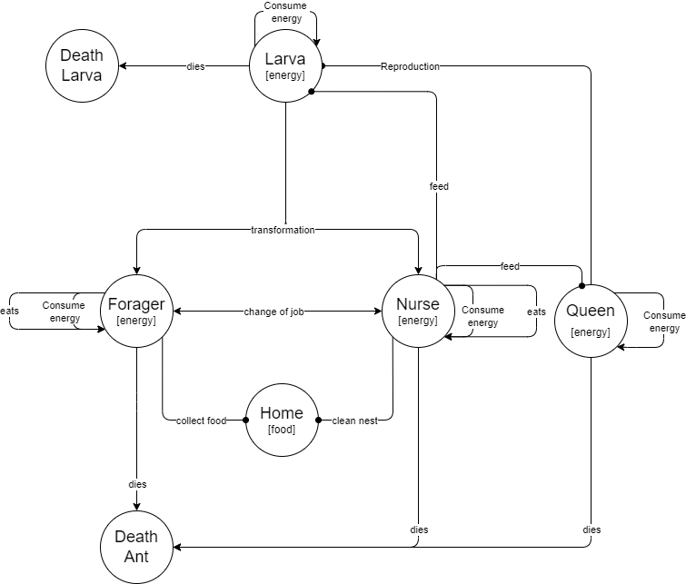
Model description
Abstract graph
All the rules and agents that interact in the colony, can be summarised with this abstract graph

Slide 14
Model dynamics: main rules
Reproduction
Q | H -[ λ ]→ Q[+1] | H | L
Consume energy
A -[ λ ]→ A[+1]
where A ∈ { Q, N, F, L }
Collect food
F | H -[ λ ]→ F[+1] | H[+3]
Feed
N | Q -[ λ ]→ N[+1] | Q[-1]
N | L -[ λ ]→ N[+1] | L[-1]
Die
A -[ λ ]→ DA
L -[ λ ]→ DL
Change work
N -[ λ ]→ F
F -[ λ ]→ N

Slide 15
Simulations
4
Results

Slide 16
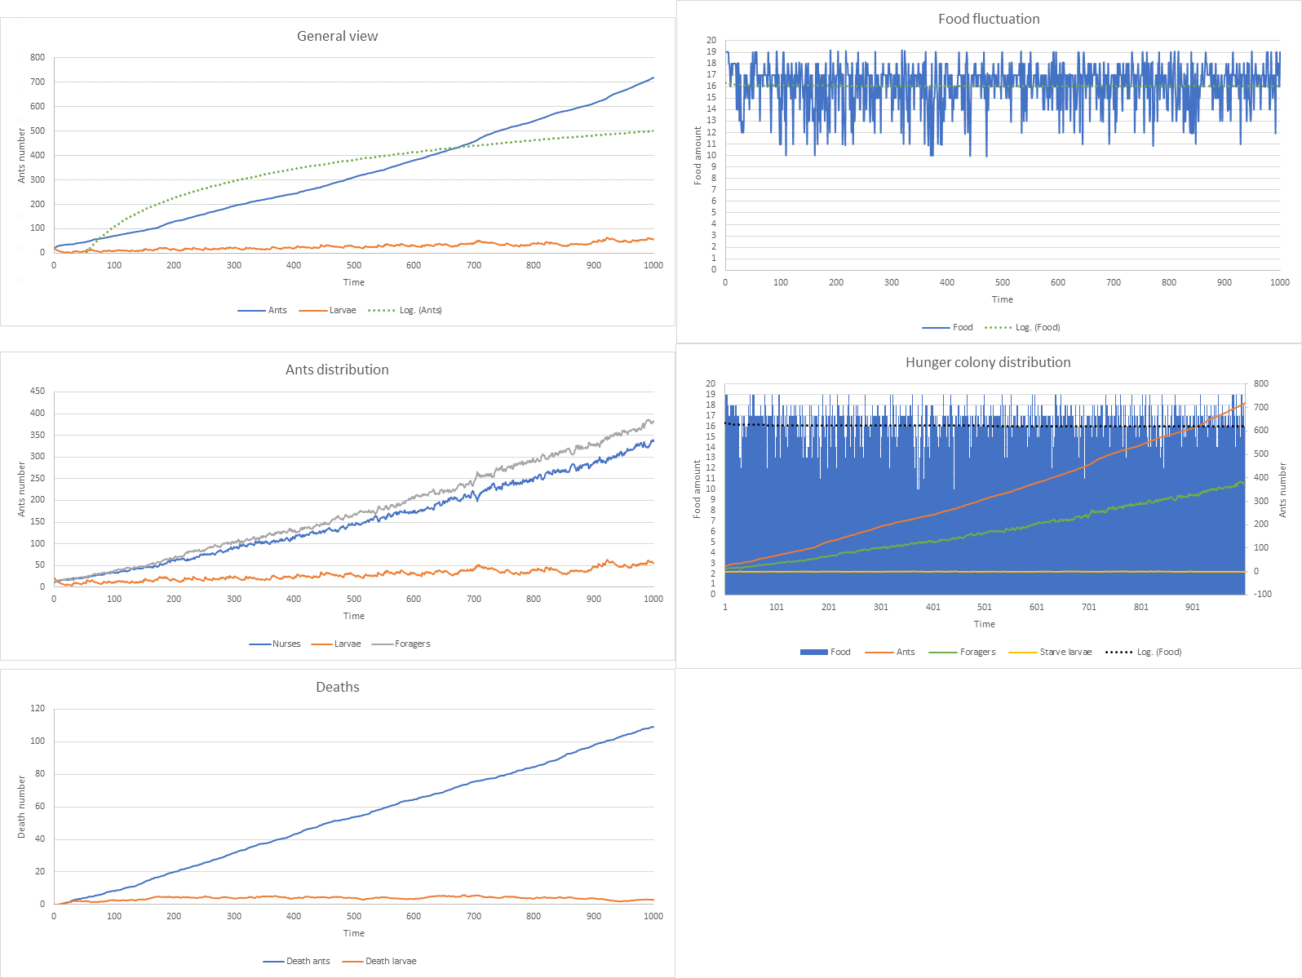
New Colony - Temperature 29 °C and Food availability 1

Slide 17
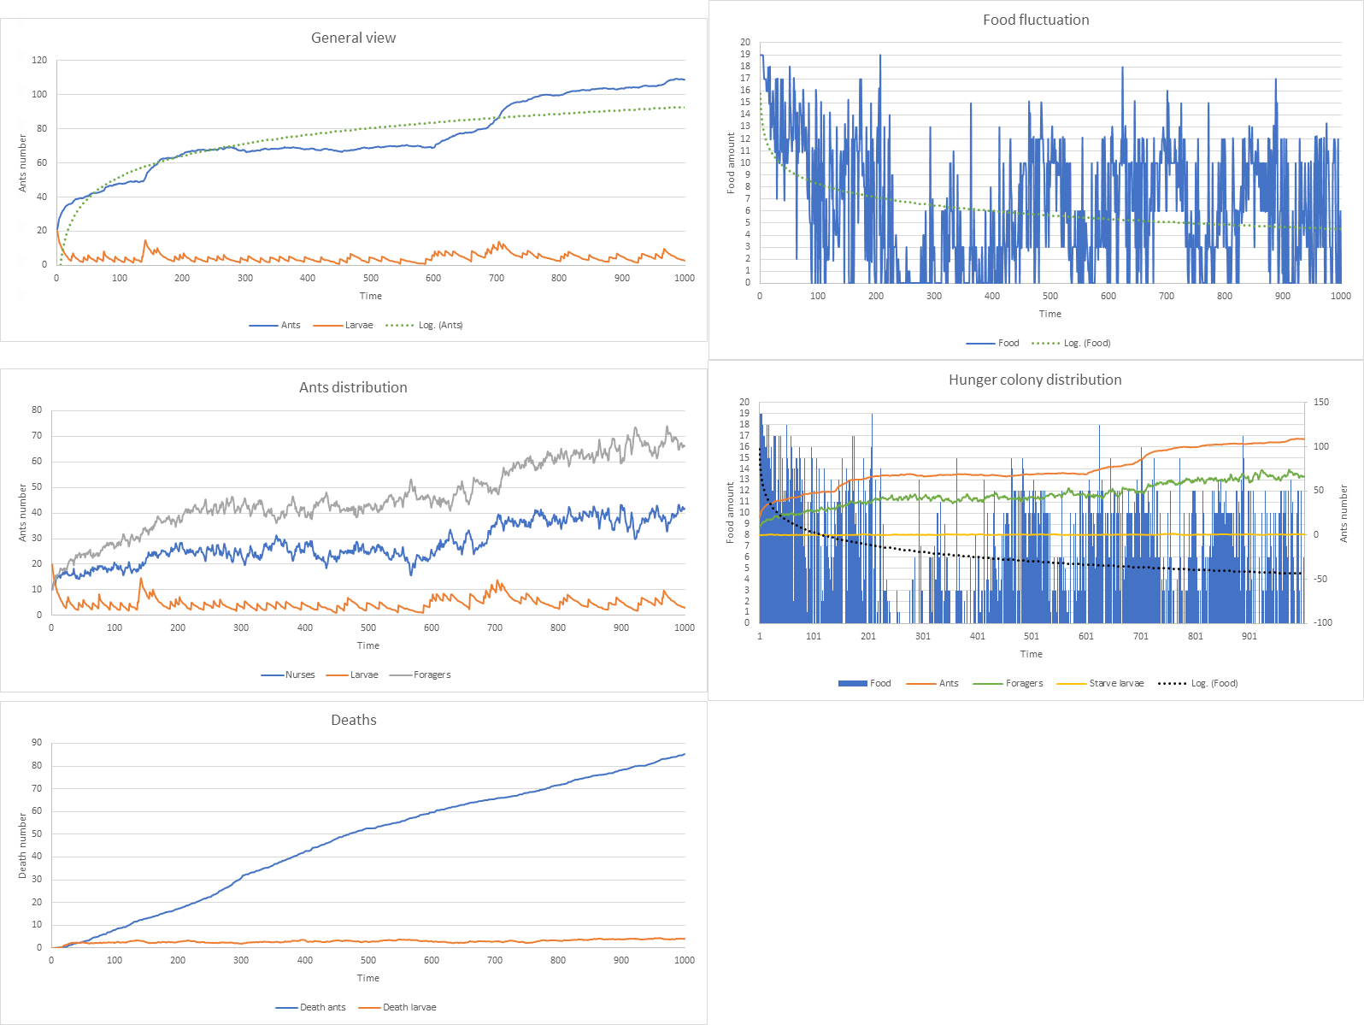
New Colony - Temperature 29 °C and Food availability 0.5

Slide 18
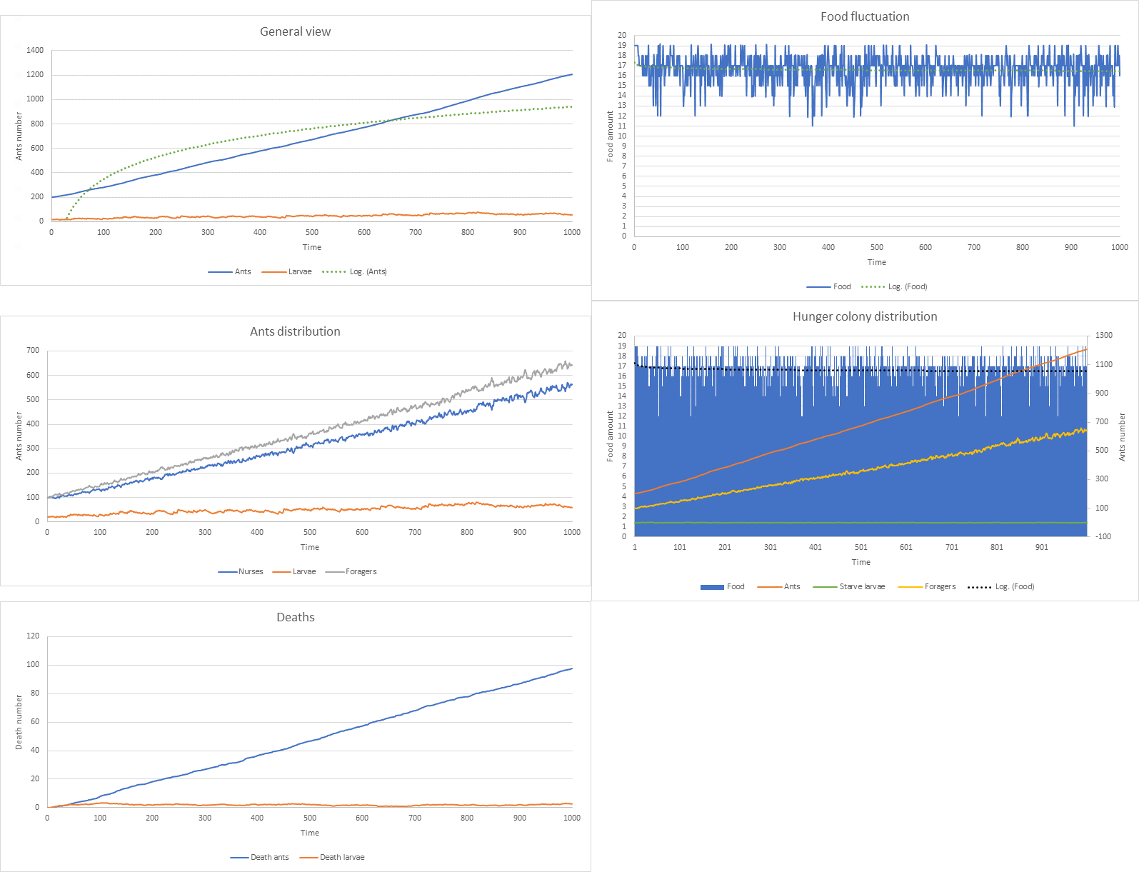
Old Colony - Temperature 29 °C and Food availability 1

Slide 19
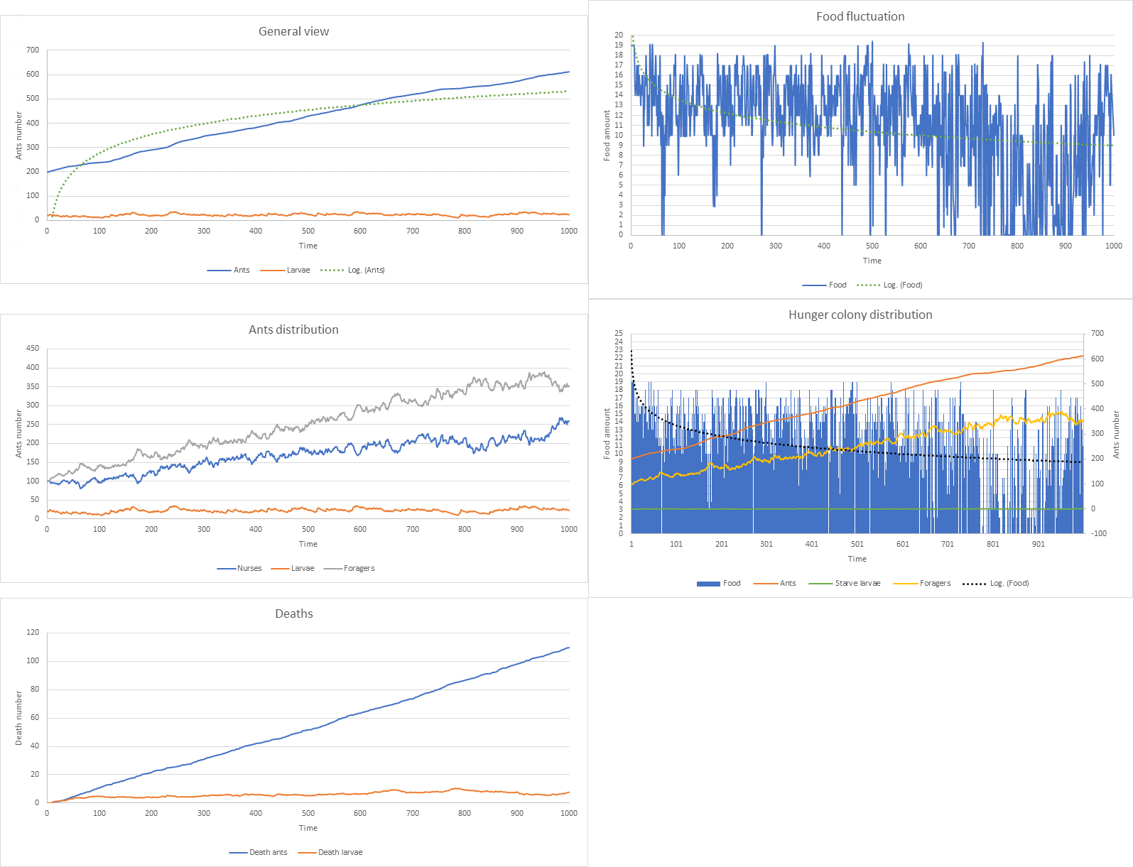
Old Colony - Temperature 29 °C and Food availability 0.5

Slide 20
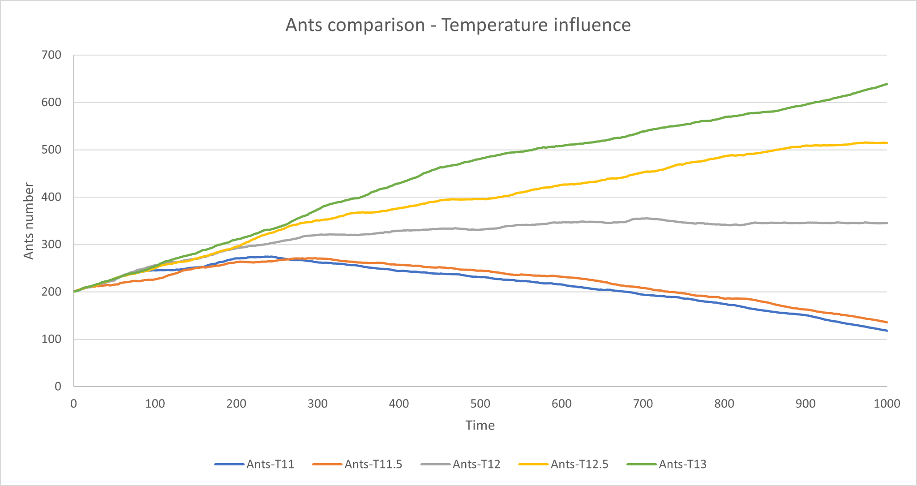
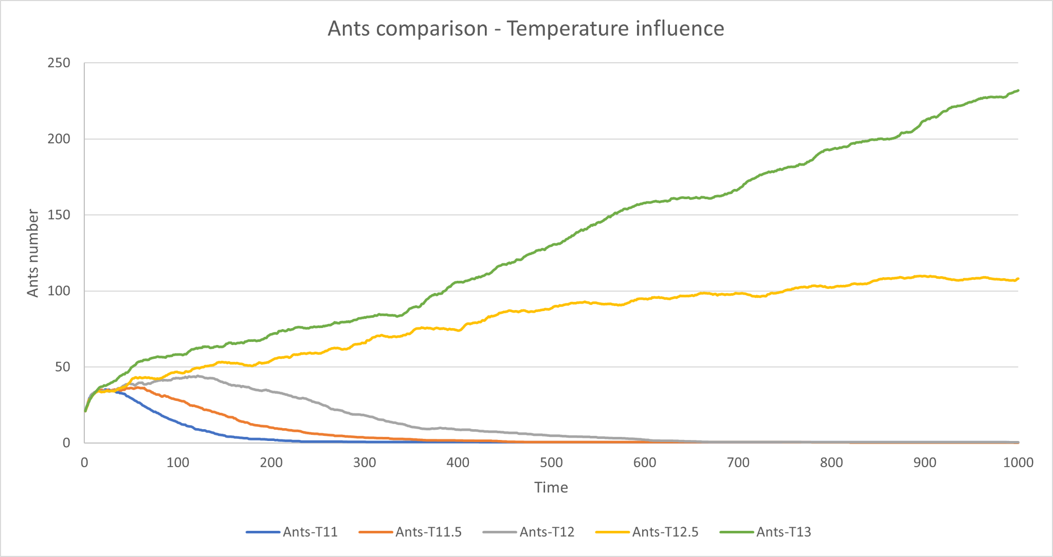
Old colony
New colony
Old Colony vs New Colony - Temperature 11 °C - 13 °C and Food availability 1

Slide 21
Conclusion
5
Analysis & Achieved results

Slide 22
Achieved results
By changing Temperature and Food, there is an impact on the colony
Temperature & Food
Can boost the colony speed if moderate
Or, can sign the colony dead
New vs Old colony
Old colony are advantaged respect to newest one

Slide 23

THANKS!
GitHub
Any questions?
You can find me at:
matteo02.romagnoli@studenti.unicam.it

